Slide 1

Terribad Entertainments presents:

Slide 2
A Terribad Entertainments Production…

Slide 3
Terribad Entertainments’ses

Slide 4
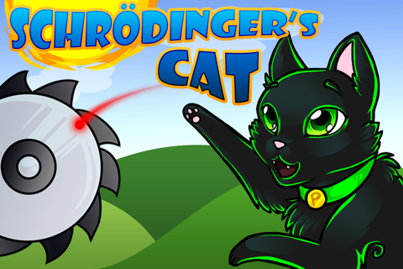

Slide 5
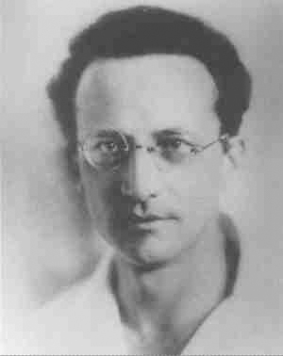
Disclaimer

Slide 6
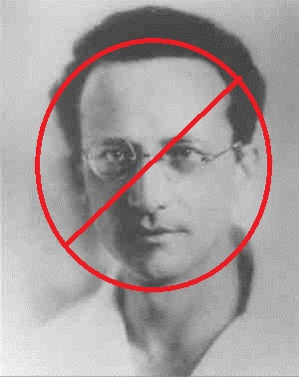
Disclaimer

Slide 7
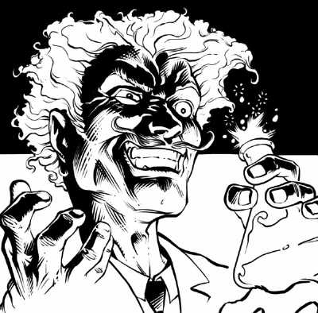
Father’s Brother’s Nephew’s Cousin’s Former Roommate

Slide 8
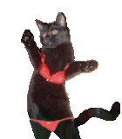
INSERT OPENING SKINEMATIC HERE

Slide 9

Overview
iPhone Implementation
Puzzle Platformer
Indirect Control Scheme
Hilarious Cat Deaths

Slide 10


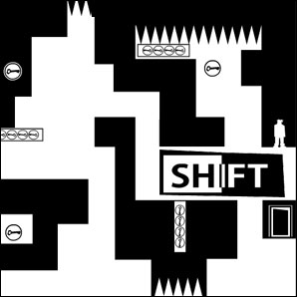


Slide 11




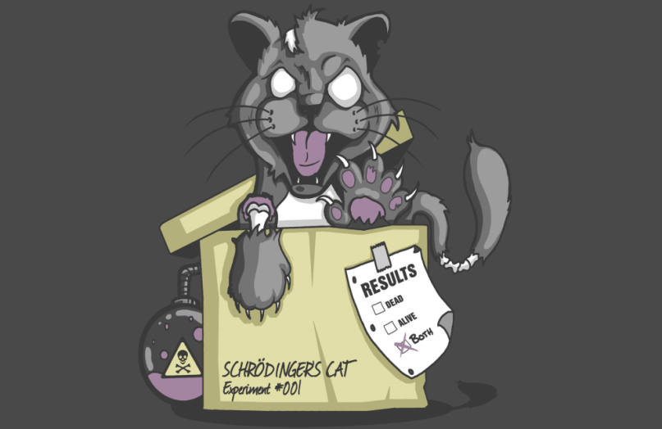
+
+
+
=

Slide 12
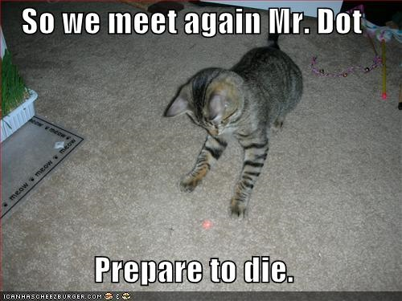
Guiding Your Cat
Random Distractions
  Short Attention Span
  Laser Pointer
  Cat Food
  Scratching Post
  Mice

Slide 13

Cat Deaths
Deaths To Solve Puzzles
ESRB Rating System vs. Time Based Score

Slide 14
zOMG DEMO!!!!11one

Slide 15

Conclusion
iPhone
Puzzle Platformer
Laser Pointer
Awesome Cat Deaths

